Slide 1
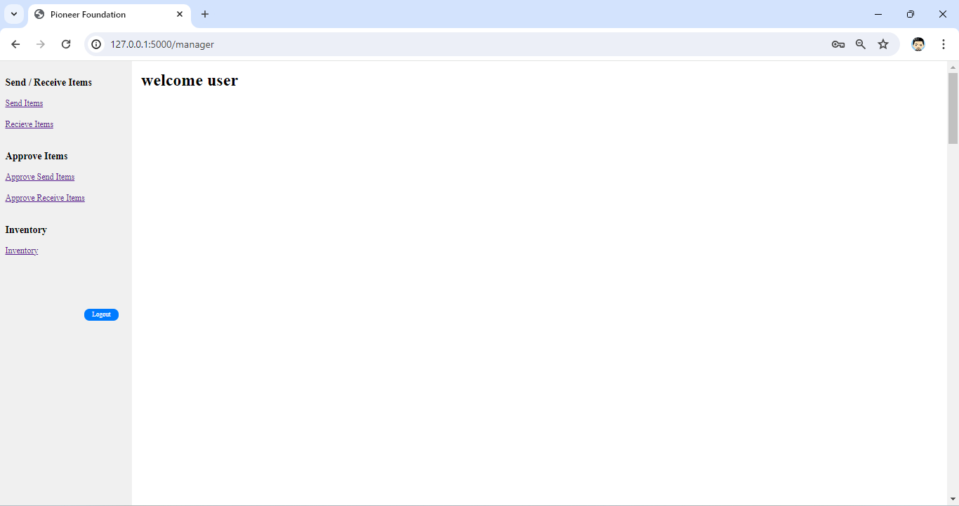

Slide 2
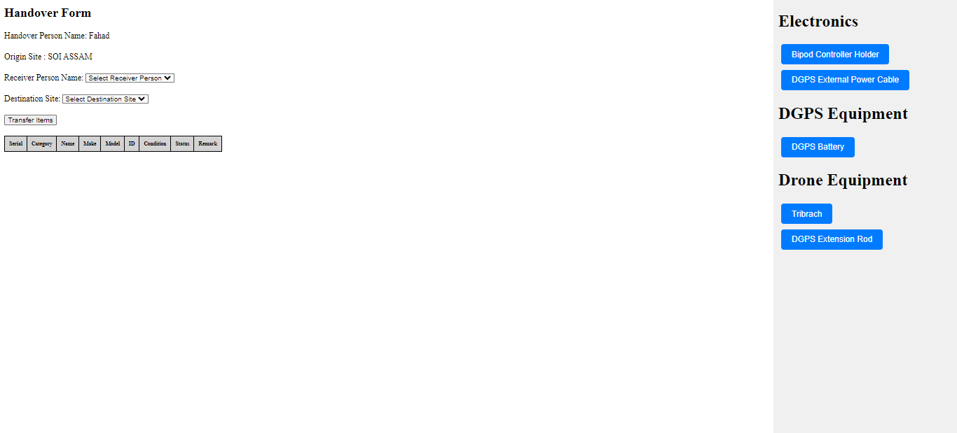

Slide 3
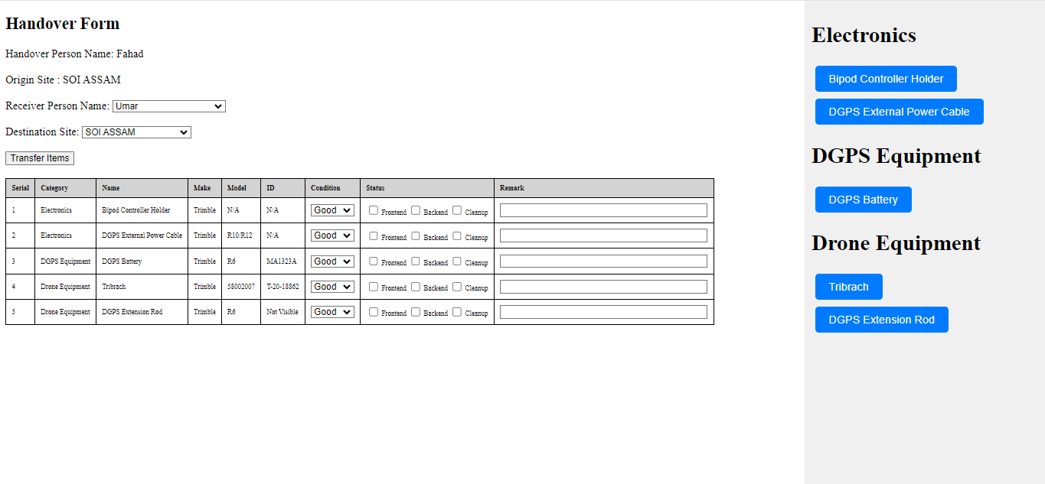

Slide 4
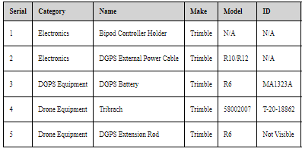
Sender Name
Receiver Name
Sender Project
Receiver Project
Message and email to two people
1. Abbas
2. Project manager
1. Whatsapp Message to abbas
Bhai kuch to hora hai
-PDF
2. Whatsapp Message to project manager
Bhai tera banda kuch to bhejra hai, uska eway bill banade please
-PDF
Eway bill banjaega to iss link pe click karke upload kardena (link to form)
http://127.0.0.1:5000/send_items

Slide 5
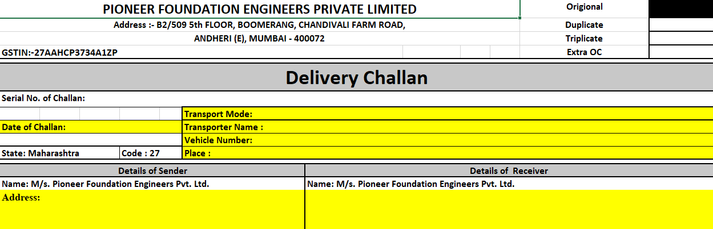
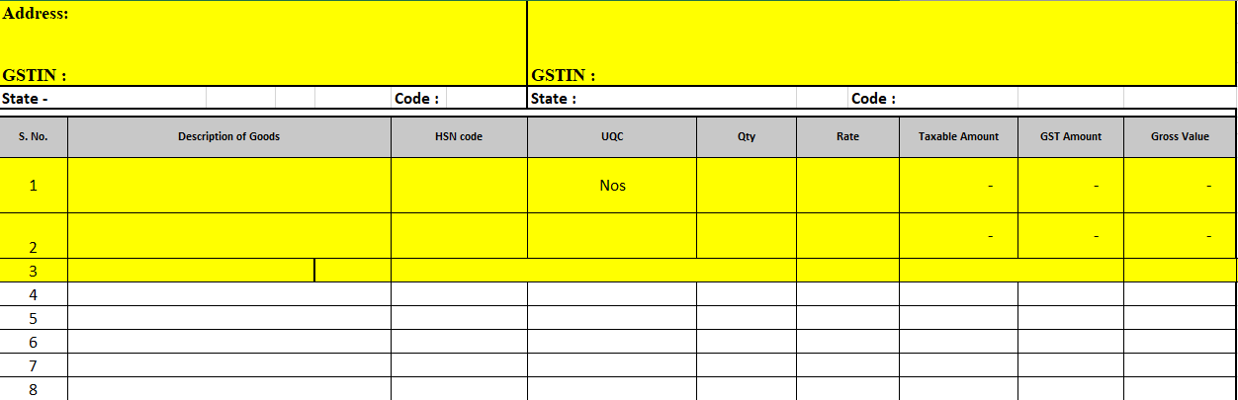
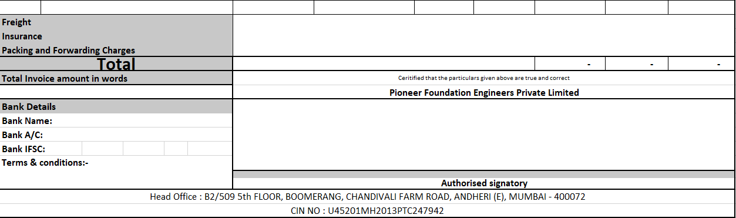

Slide 6
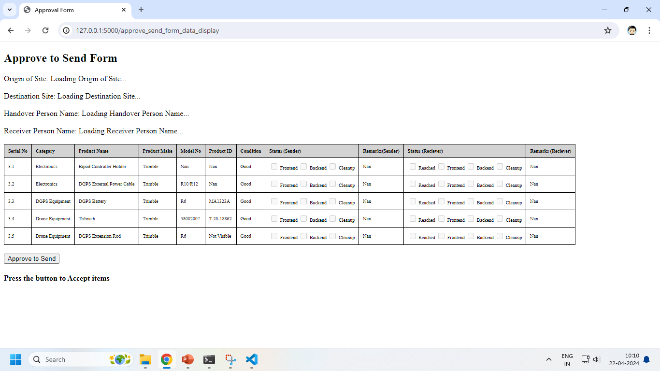
Manager has steps to do
1. Open excel
2. Put the values from
the pdf in the excel
3. Send this sheet to accounts
department through mail
4. Accounts department will make an
original government registered eway bill
5. Send it back to the manager
6. The manager will then upload
this original gov bill on the form
This is done to ensure that the pdf with just the list items have been legally converted to an government authorized eway bill
before sending the goods

Slide 7
Send WhatsApp Message to sender and receiver
Sender: Approval has been accepted, you may proceed to send items
Receiver : A parcel has been accepted towards your destination.

Slide 8
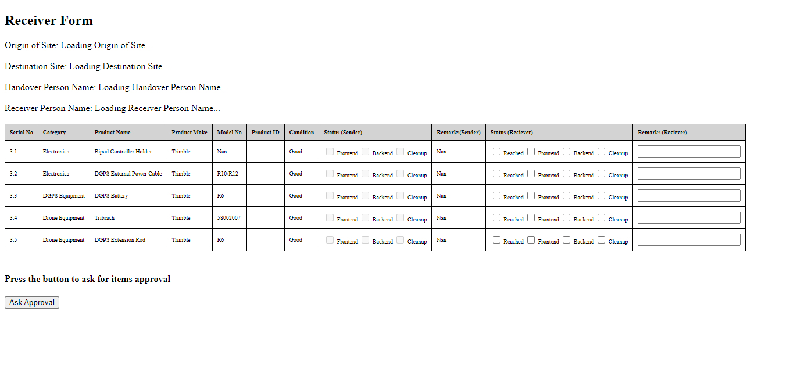
Send WhatsApp Message to Receiver Manager
Message : An items approval is in pending, please approve. The link is :
http://127.0.0.1:5000/#bill-986abd/receive_items

Slide 9

Send WhatsApp Message to Receiver Back indicating approval has been accepted
Message: Your approval has been accepted and have been transferred to your name and project. You may proceed to use them

Slide 10
The End !

Slide 12
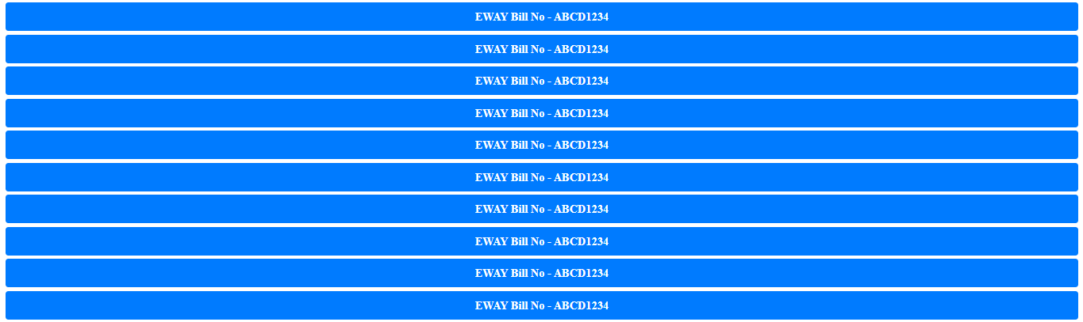
Search EWAY BILL

